Slide 1

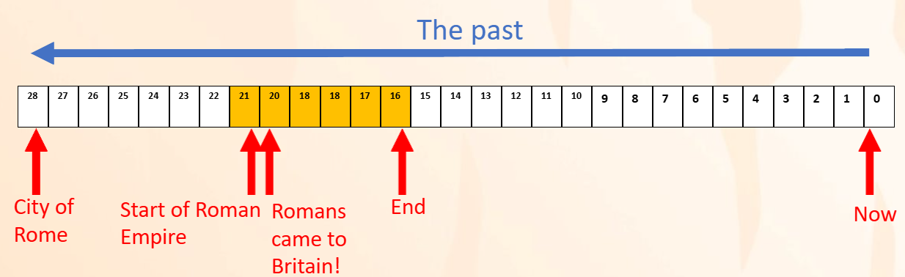
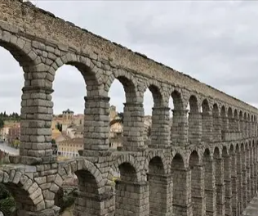
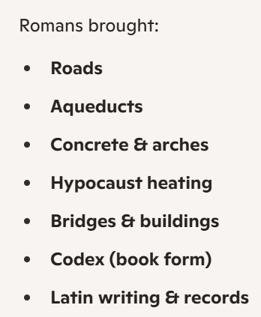
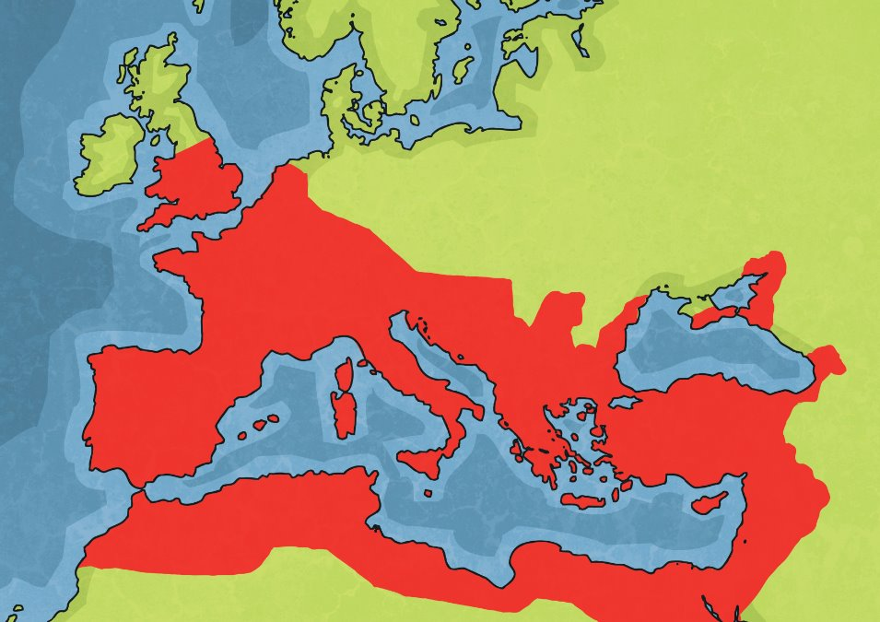

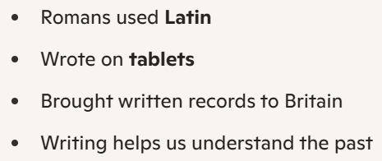
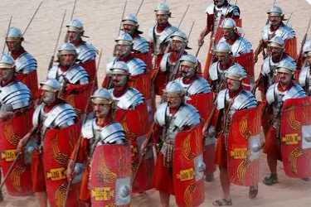
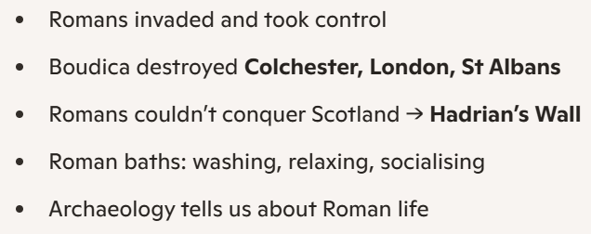
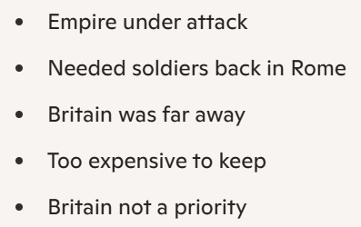
Word | Definition
Romans | People who lived in Rome and built a huge empire.
Empire | A group of countries or lands ruled by one powerful leader.
Invade | To enter another place with an army and try to take control.
Iceni | A Celtic tribe who lived in Britain; Boudica was their queen.
Boudica | A brave Iceni queen who fought against the Romans.
Britain | The land the Romans invaded and ruled for many years.
Emperor Claudius | The Roman leader who invaded Britain in 43 AD.
Emperor Honorius | The Roman leader who told soldiers to leave Britain.
Aqueduct | A long structure that carries water from one place to another.
Hypocaust | A Roman heating system that warmed floors and rooms.
Archaeology | Studying old objects and ruins to learn about the past.
Latin | The language Romans spoke and wrote.
Timeline | A line showing events in the order they happened.
Trade | Buying, selling, or swapping goods between places.
Settlement | A place where people live, like a town or village.
Rebellion | When people fight back against rulers or unfair treatment.
Hadrian’s Wall | A long wall built by the Romans to mark the border with Scotland.
Baths | Roman buildings used for washing, relaxing, and meeting friends.
Soldiers | People who fight in an army.
Evidence | Clues from the past, like artefacts or ruins.
Artefact | An object made or used by people long ago.
THE ROMANS – KNOWLEDGE ORGANISER (YEAR 1/2) Focus: The Romans’ impact on Britain
Roman inventions/achievements
When did they live?
Came from Rome, Italy
Controlled a huge Empire across Europe, Africa & the Middle East
Had a powerful army
Trade connected Britain to Europe
Helped spread Christianity
Who were they?
Key people
Roman Britain
Roman Britain
Why did they leave Britain?

