Slide 1

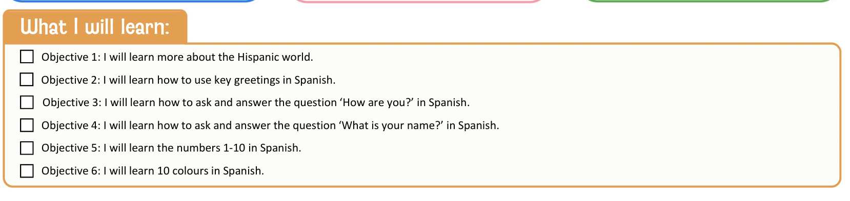

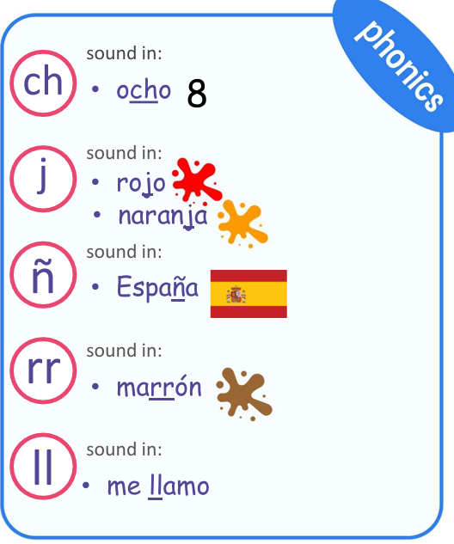
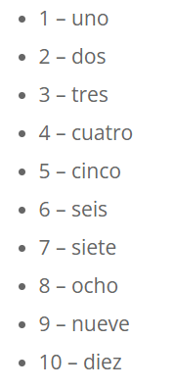
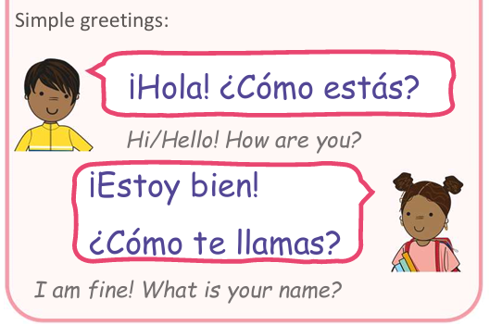

Year 3 Knowledge Organiser – I Am Learning Spanish
amarillo
rojo
marron
azul
morado
negro
gris
naranja
azul
blanco

