Slide 1

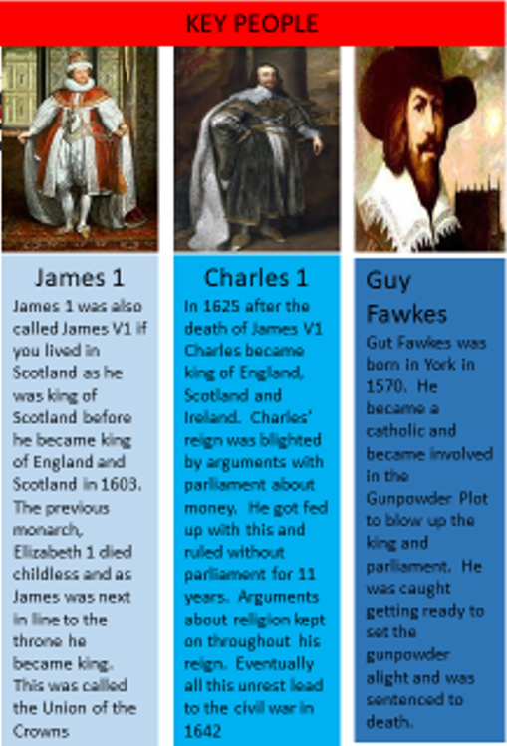

History - Monarchs of the House of Stuart
Year 4
Key Vocabulary
Vocabulary | Definition
Divine Right of Kings | The King can’t be told what to do by any human and takes his authority from God.
Heir | A person who has the legal right to receive someone else's money, property, or title (like a crown or a family name) after that person dies
Union of The Crowns | When England and Scotland were ruled by the same King (James I of England and James VI of Scotland)
Monarch | It is a single ruler of a country, such as a king, queen, emperor, or empress.

