Slide 1

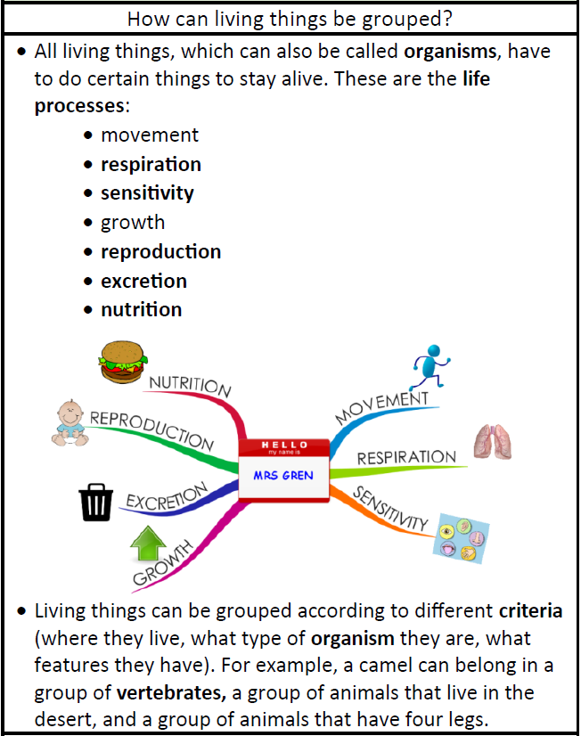
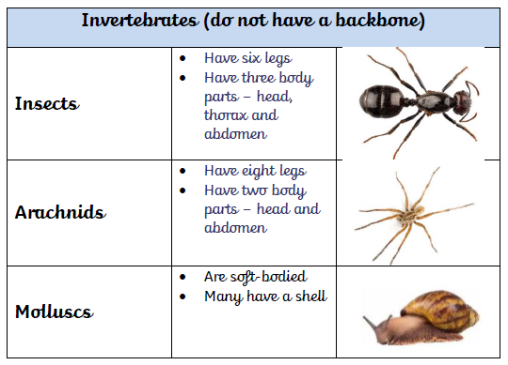
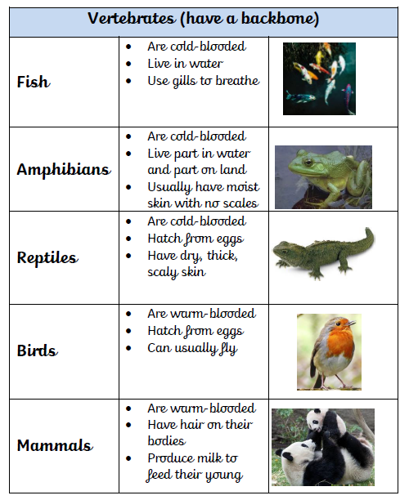
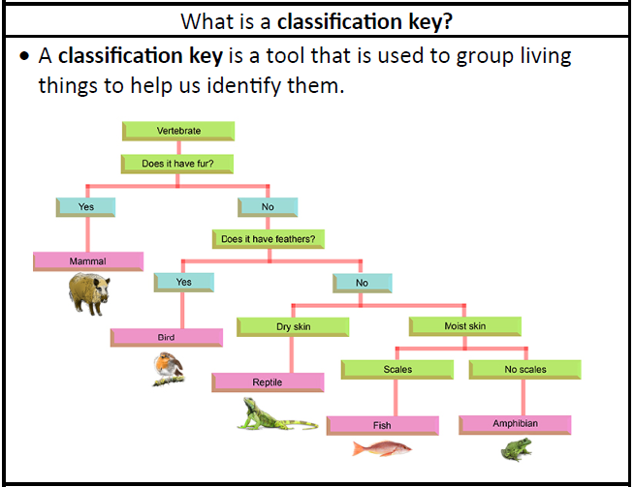
Science – Classification of Animals
Year 4

Slide 2
Science – Classification of Animals
Year 4
Vocabulary
amphibian | Small vertebrate that needs water/moist environment
biomes | A natural area of vegetation and animals
carnivore | An animal that eats meat
Classification Key | A system which divides things into groups or types
Criteria | A factor on which something is judged.
excretion | The process of eliminating waste from the body.
habitat | A natural environment
herbivore | An animal that only eats plants
invertebrate | A creature that does not have a spine
mammal | Warm blooded vertebrates that feed their young with milk.
omnivore | An animal that eats plants and meat.
organism | A living thing
reproduction | When an animal or plant produces individuals similar to itself
respiration | Process of respiring; breathing; inhaling and exhaling air
sensitivity | Responding to the external environment
vertebrate | A creature which has a spine

