Slide 1

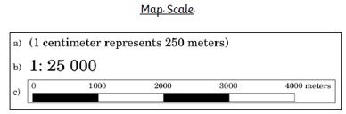
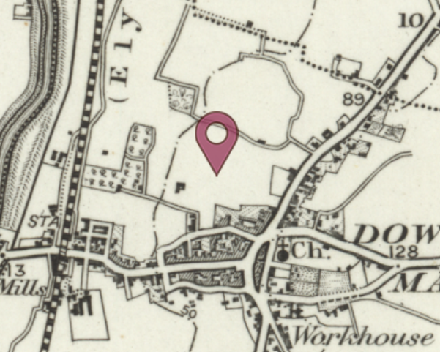
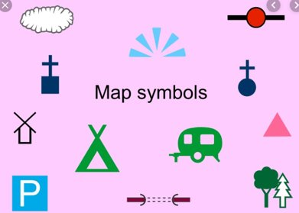
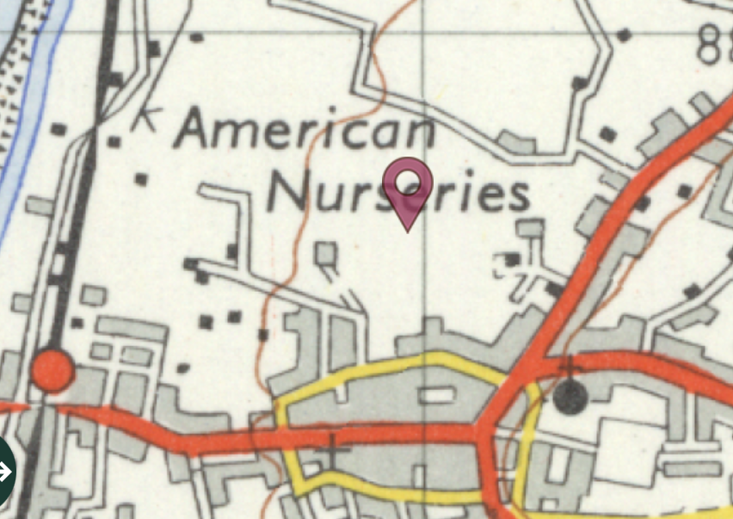
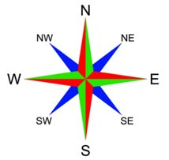
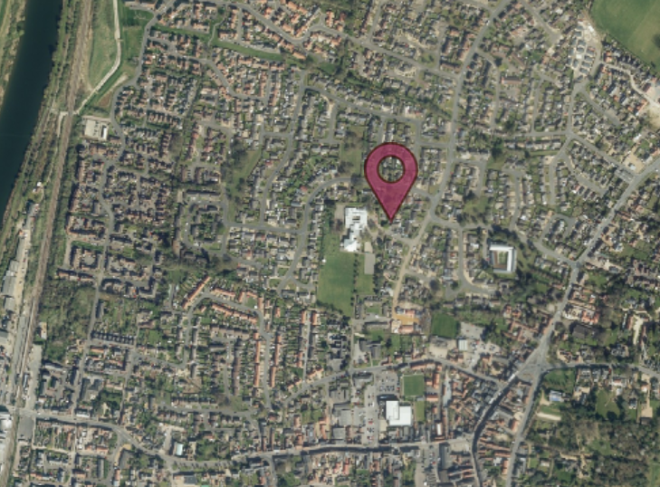
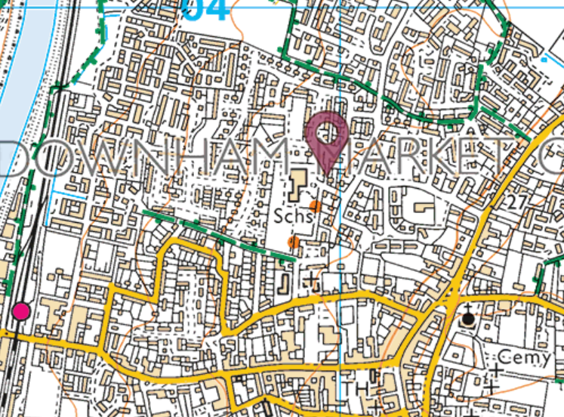
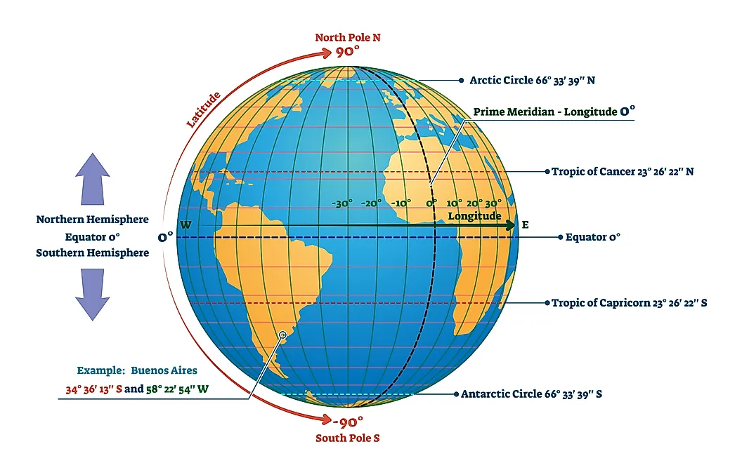
Geography – Spatial Sense/Local Area Study
Year 4
a).
Vocabulary​ | Definition​
scale​ | Map scale refers to the relationship (or ratio) between distance on a map and distance on the ground. For example, on a 1cm:1km scale map, 1cm on the map equals 1km on the ground.​
symbol​ | Cartographers (people who draw maps) use different symbols on maps to represent real features from the world. A symbol is a simple and quick to draw picture.​
key​ | A key explains what colours and symbols mean.​
population​ | The number of people living somewhere.​
Land use​ | What the land is used for – housing, farming etc…​
Aerial (view/photo)​ | Pictures/photos of the earth, taken from above.​
Maps change over time
These maps all show our school's local area.
From top a).1890s, b).1950s and c).2000s.
b).
c).
Lines of Latitude
Lines of Longitude
Equator
Prime Meridian
Tropics of Cancer and Capricorn

