Slide 1

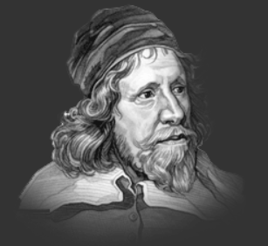
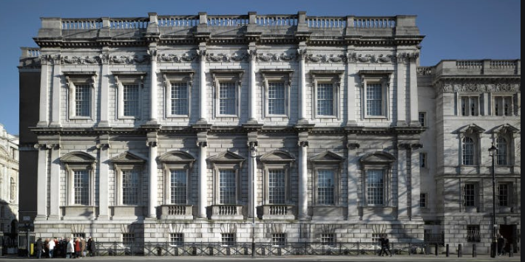
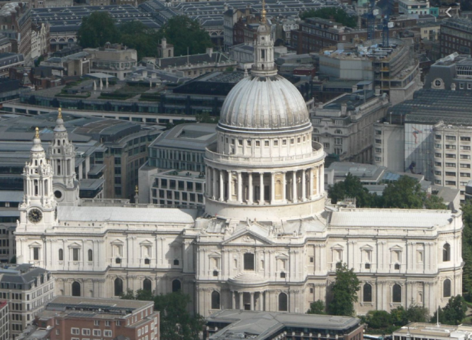
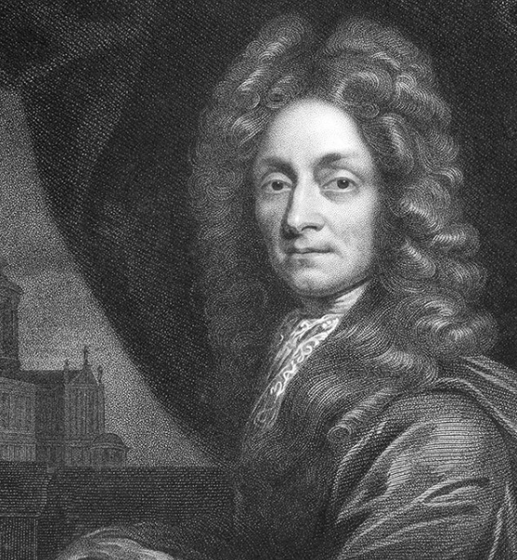
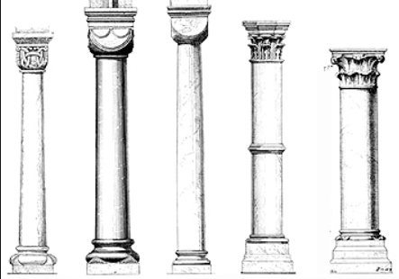
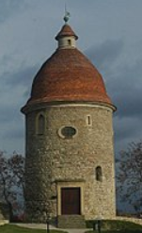
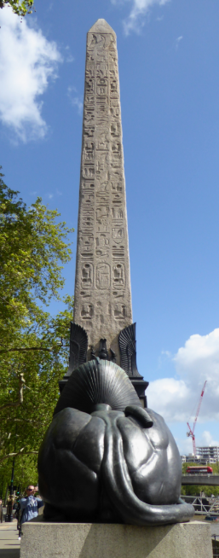
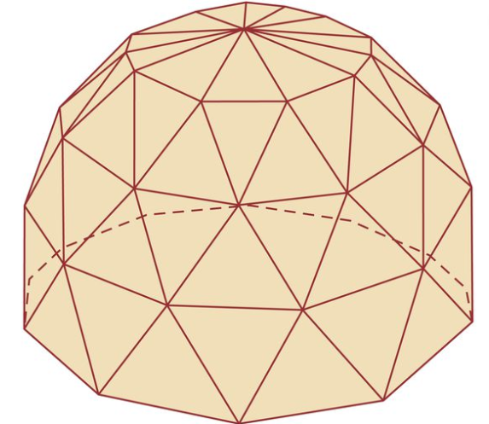
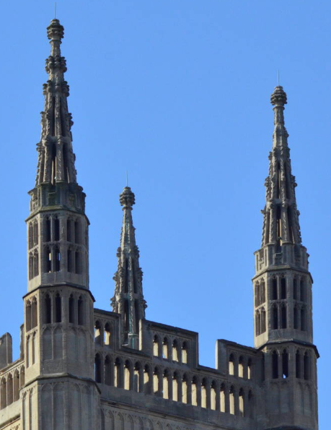
Art – architecture
Year 4
Inigo Jones (15 July 1573 – 21 June 1652) was the first English architect in the early modern period, and the first to use proportion and symmetry in his buildings.
Vocabulary | Definition
Neo-classicism | Style taken from Rome and Greece. Simple in form and used mathematics and symmetry.
Baroque | Ornate (highly decorated) style of art.
Dome | A hemisphere, usually creating a roof or ceiling.
Geodesic Dome | A dome with many faces. The structure uses triangles.
column | A pillar that supports weight from the load above.
Pinnacle | It is a decoration that looks like a small spire.
Rotunda | A building with a circular base (looks like a cylinder)
Obelisk | A tall, pointed stone pillar.
monument | A statue, building or structure built to remember something or someone.
Adorn | Make something beautiful.
Banqueting House - Whitehall
Sir Christopher Wren (October 20, 1632 - February 25, 1723). Famous designer, astronomer, and the greatest English architect of his time.
St Paul’s Cathedral
Architectural features
column
Obelisk
pinnacle
rotunda
Geodesic Dome

Slide 2
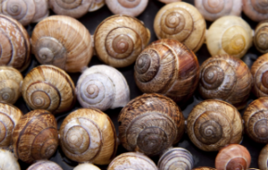

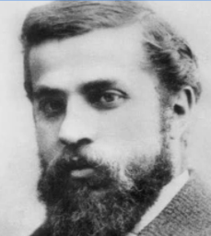

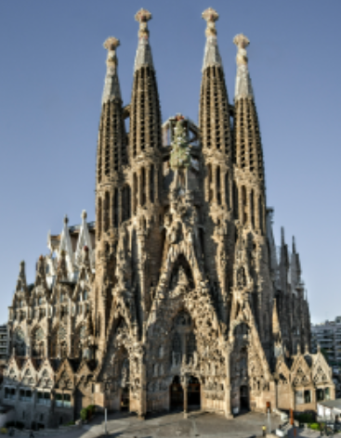
Art – architecture
Year 4
Gaudi was inspired by nature and this can be seen in his designs.
Vocabulary | Definition
Catalan | (Spanish) spoken in some areas of Spain.
Modernist | Believed in experimentation and abstract.
Trencardis technique | Joining together broken pieces of tiles.
Mosaic | Stones, glass, ceramics or tiles (tesserae) that are set in a base to create a picture or pattern.
Antoni Gaudí (1852-1926) was a Catalan modernist architect known internationally as a genius. He created his own style in the modernism of the time. His most famous work of art is the Sagrada Familia in Barcelona, which is visited by millions of tourists every year.
Segrada Familia in Barcelona.

