Slide 1


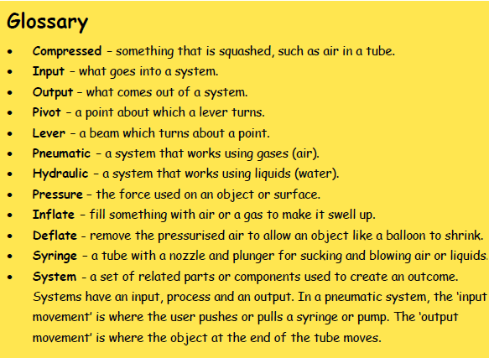
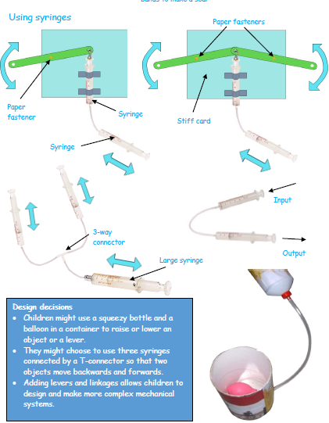
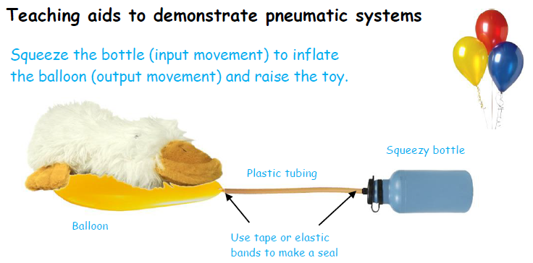
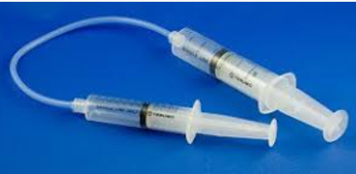
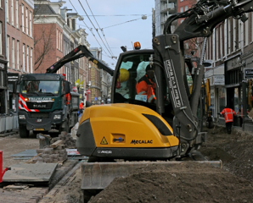
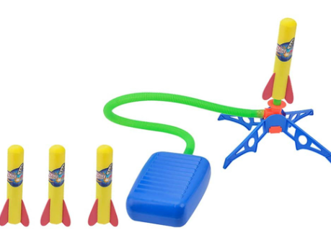
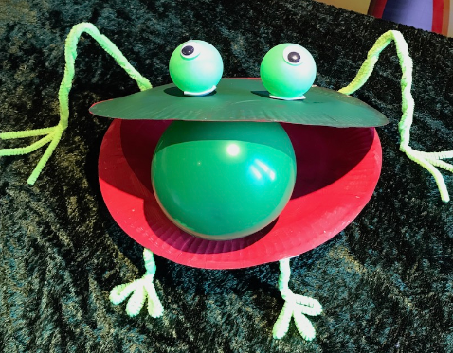
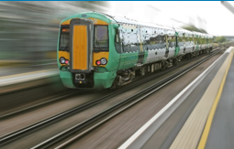
Year4 DT- Mechanical Systems: Pneumatics
Pneumatic systems:
Pneumatics in everyday life
Using pneumatics in toys
Pneumatic drills, brakes on modes of transport,
buses which raise and lower to let people on and off, compressed air used at dentists, and spray guns to spray-paint cars.
The clue pneumatics are involved is the hissing sound of the air.

