Slide 1
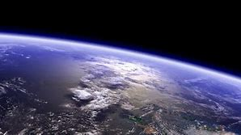
OUR ECO ASSEMBLY
By Elija, Emilia and Eloise

Slide 2


Slide 3
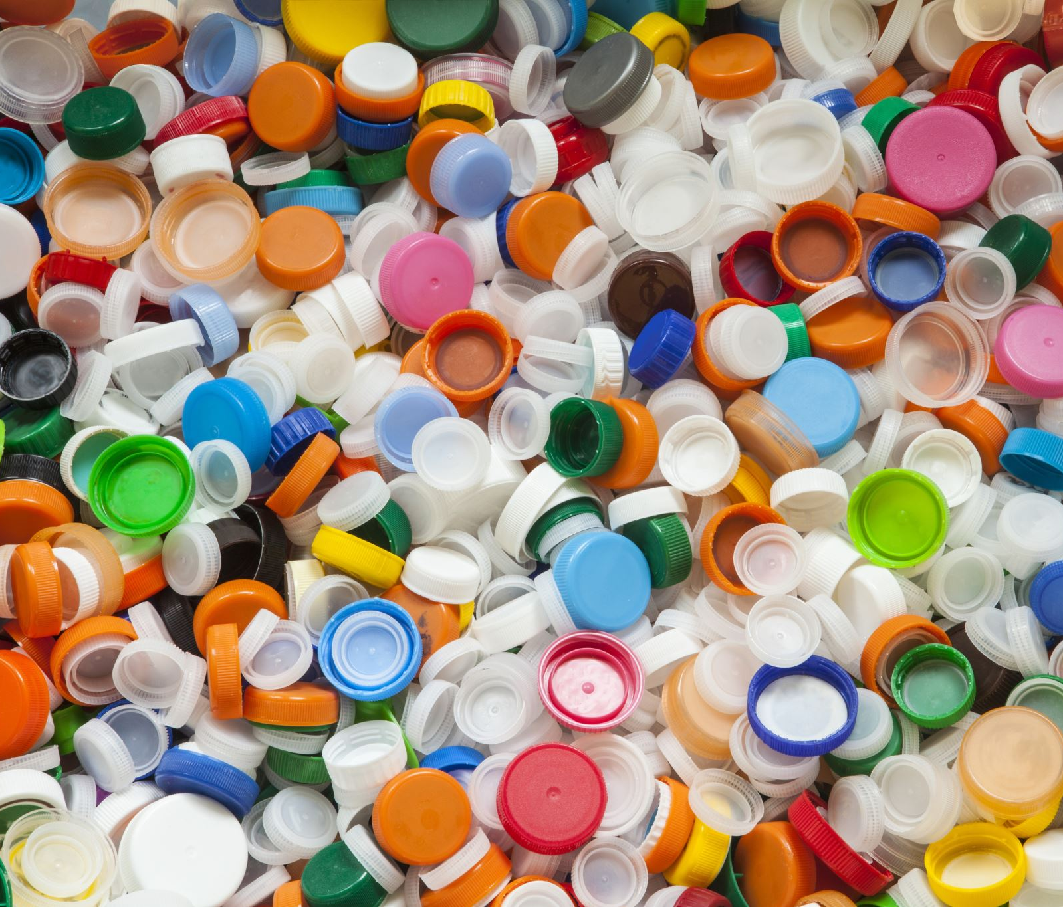

RECYCLE!!
Recycling is the process of taking different materials and recycling them so they can be used all over again.
Recyclable plastic can only be recycled 2 or 3 times before it can't anymore.
Recycling reduces the quantities of solid waste deposited in landfills which have become increasingly expensive.
Recycled jeans can be shredded and compressed into panels for insulation.
Pineapple leaves can be processed into a leather-like material.

Slide 4
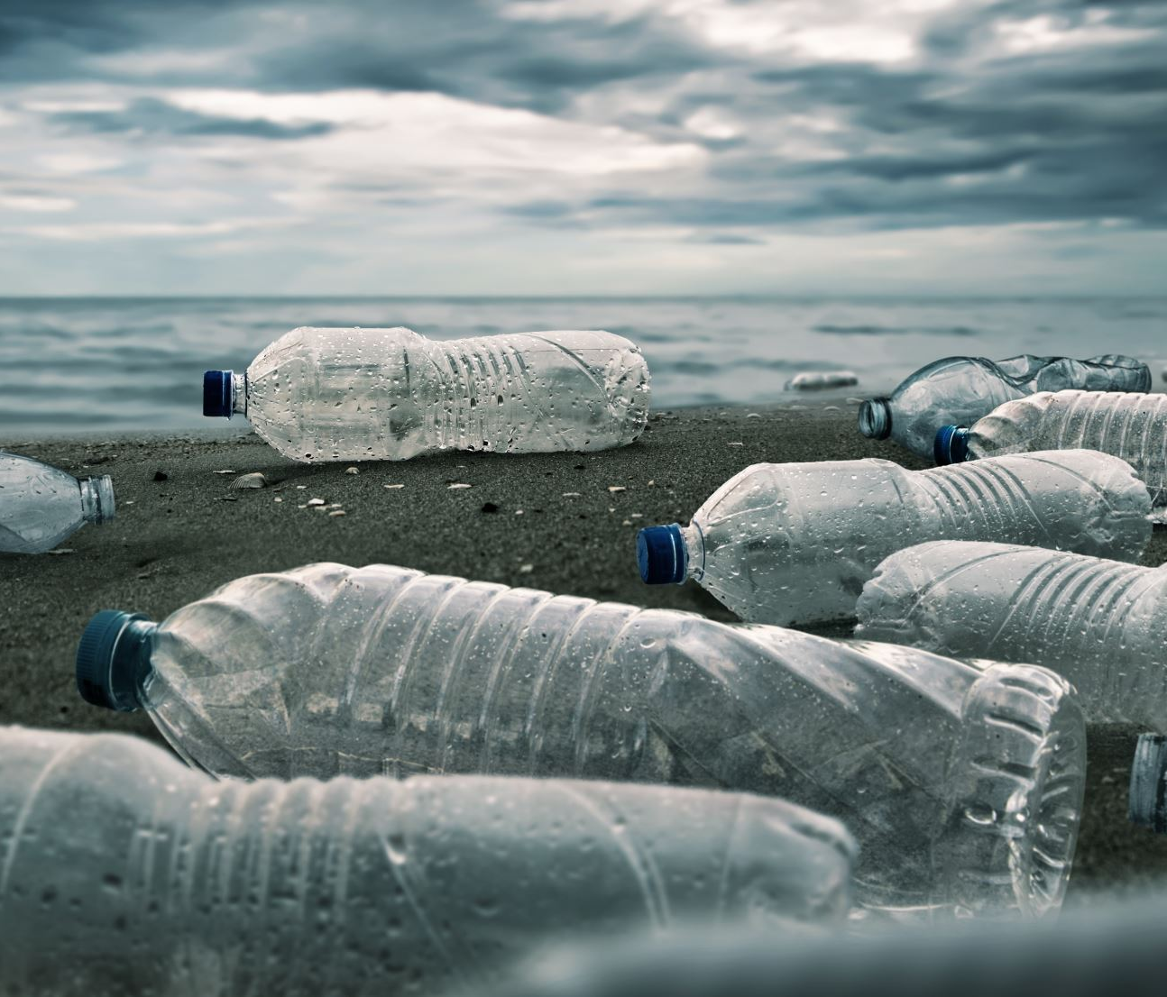

REUSE!!
Bring reusable water bottles to school instead of single-use plastic bottles because reusable ones last longer and don’t need to be thrown away.
There are simple ways to save the planet but it’s also one of the toughest things to do- getting people to change their minds. Here’s an example- how do you get people to reuse the same bag instead of begging different shops to have different ones every time? The answer is to nudge them to reuse the shopping bags. In recent years, government have told shops to charge the customers for plastic shopping bags. The charges are tiny, but the impact is HUGE. 25% of the bottled water you buy is

Slide 5

REDUCE!!
Check what you throw away. Can it be recycled, reused or repaired? We need to reduce the landfill waste, as hundreds of items sit there for hundreds of years.
Buying things can be bad for planet too because 45% of global greenhouse gas emissions comes from the production of the things we use and buy daily. Maybe go to the local library and borrow that book you really want to read or ask your friend to borrow their toy instead of buying a new one. Also, when you grow out of your clothes, why not pass them on to you sibling, or give them to charity. When you draw, rub it out if you do something wrong instead of getting a new piece of paper and draw on the other side as well. All these things make a huge impact to the environment.

Slide 6
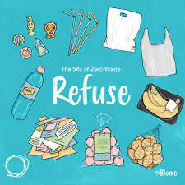
REFUSE!!
Instead of buying single-use plastic, buy things you can reuse again and again. Refuse to littering and pick up as much rubbish as you can off the floor. Refuse to throwing things away you can reuse, repair or recycle, otherwise it will go to landfill and sit there for hundreds of years.

Slide 7


REPAIR
Repairing things instead of throwing them away is important, because if you just throw the thing away, it will go to landfill. Try to patch up old clothes that get holes in them or fix your bike instead of getting a new one.

Slide 8
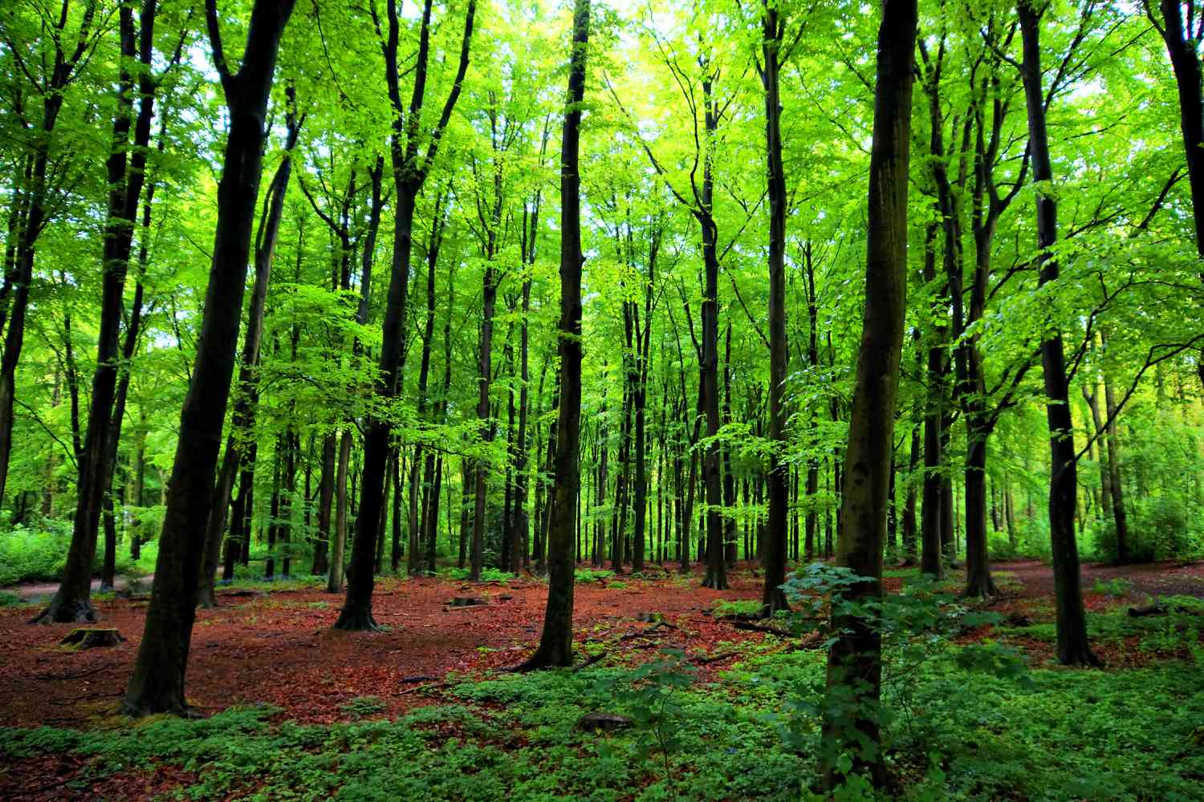
SAVE OUR TREES!
Trees are amazing!!
They absorb carbon dioxide (which is bad for our lungs) and let out oxygen into the air, which is what we breathe every day. Obviously, they are also very beautiful, especially in autumn.
Also, lots of animals live and hibernate in trees, like birds, squirrels, and badgers

Slide 9


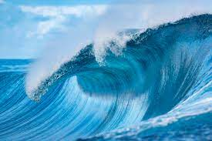
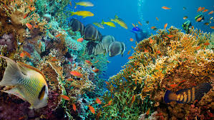
OUR OCEANS
.71% of earth is water
.There are more pieces of plastic in the ocean than stars in the milky way.
.There is enough salt in the ocean to cover the whole of earths surface
.Less than 10% of the world's ocean is not found on maps

Slide 10
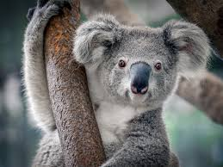
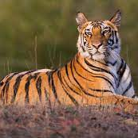
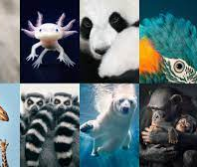
Our animals need our help
Lots of animals are endangered and could go extinct if we don’t help. Giant pandas to African elephants, they need our contribution and dedication to save them.
So many trees are cut down that animals lose their habitats and food sources which makes it difficult for them to survive.
Animals like the Dodo bird and Tasmanian tigers went extinct because we didn’t care for them enough.

Slide 11
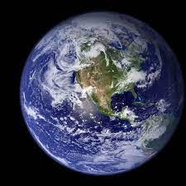

Summary
Our planet needs your help, everyone can contribute.
Endangered animals are scattered over the whole world and desperately need saving.
Think about your actions and recycle, reuse, reduce, refuse and repair as much as possible, and together, we can save our wonderful world.

