Slide 1
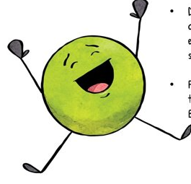
Cromwell’s Thankful Thursday Thoughts
An awesome alphabet of things we are
thankful for

Slide 2
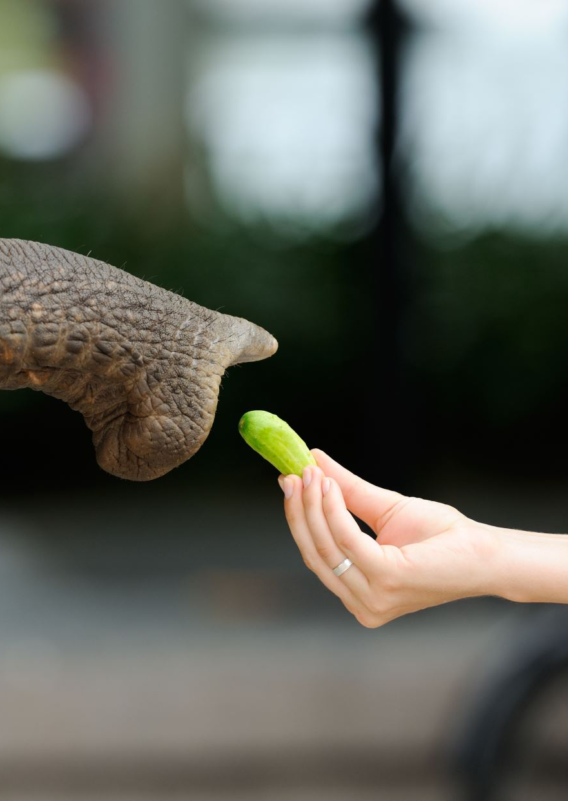
A
Animals
Attenborough
Art
Activities
Arran

Slide 3

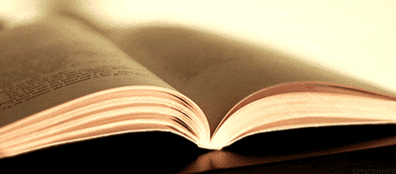
B
Books
Buildings and builders
Bins
BINGO!
BIG BANG
Brothers (most of the time!)
Beef
Breath
Bodies
Bats (animal and for hitting a ball)
Beauty (and the beast)

Slide 4
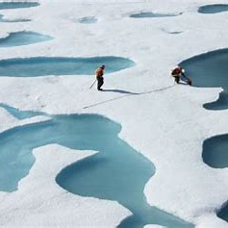
C
Carnivores Cromwell Class
Climate activists Connor
Culture Cats
Carrots Computers
Cactus Counting
Cans Clean things
Crocodiles Community
Christmas

Slide 5

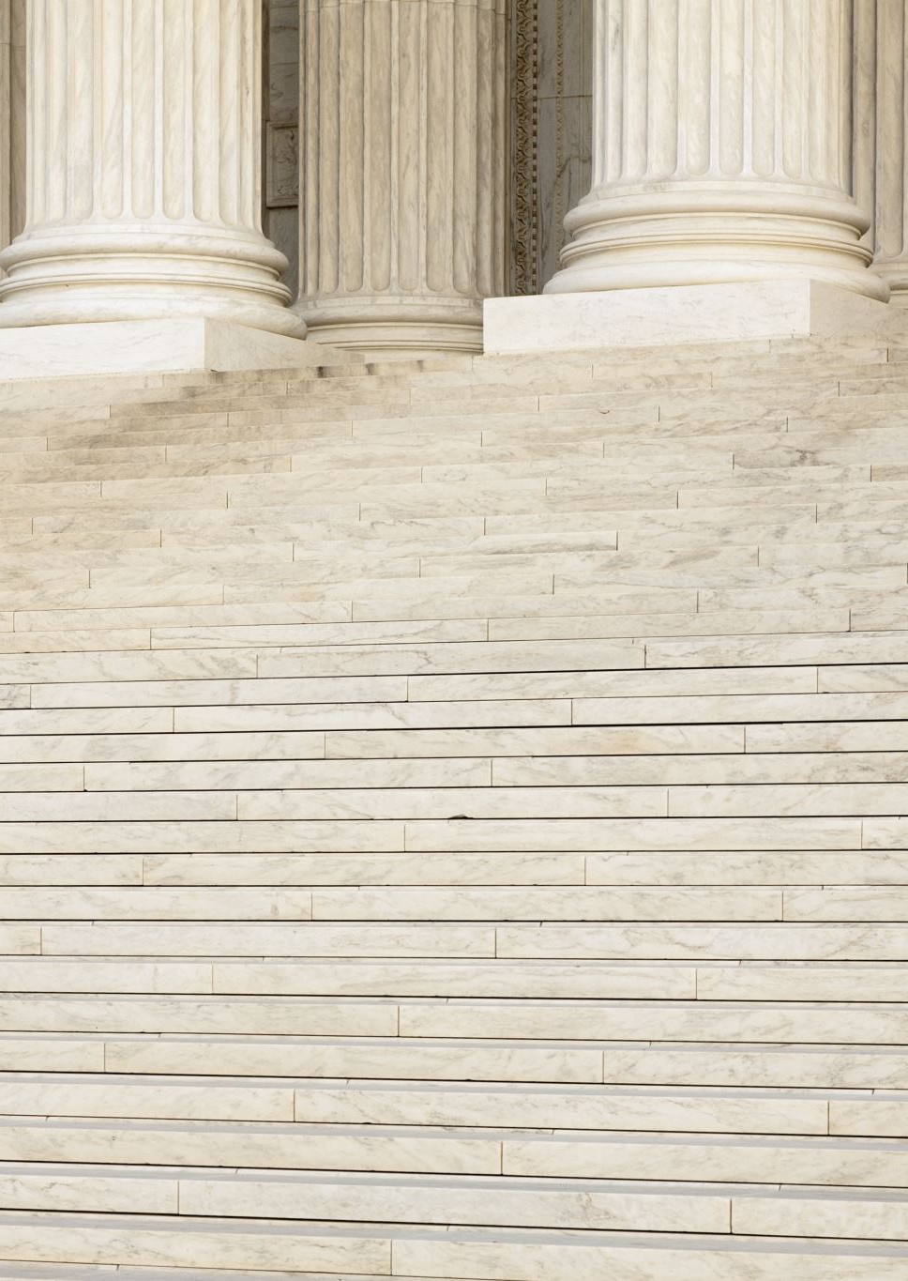
D
David Walliams
Democracy
Dad
Danila
Daisy

Slide 6
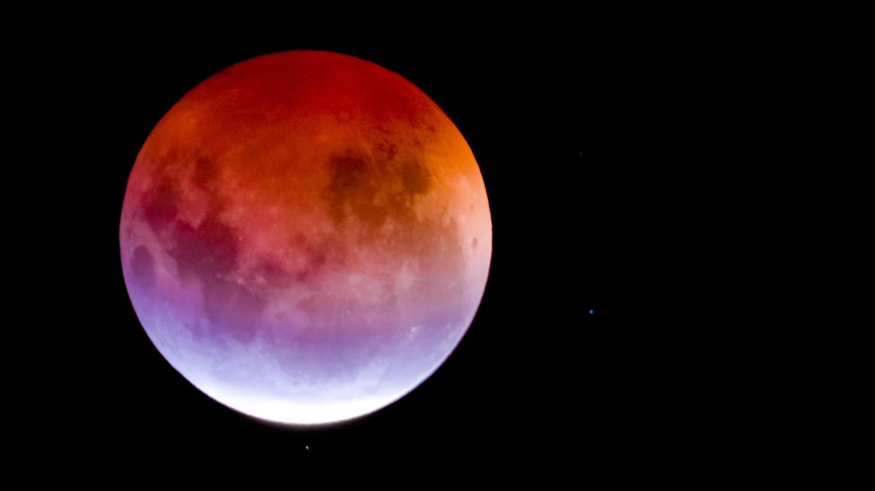
E
Eclipse
Environment
Ella
Ellie
Evie
Eva
England
Elf
Ears
Edshed

Slide 7

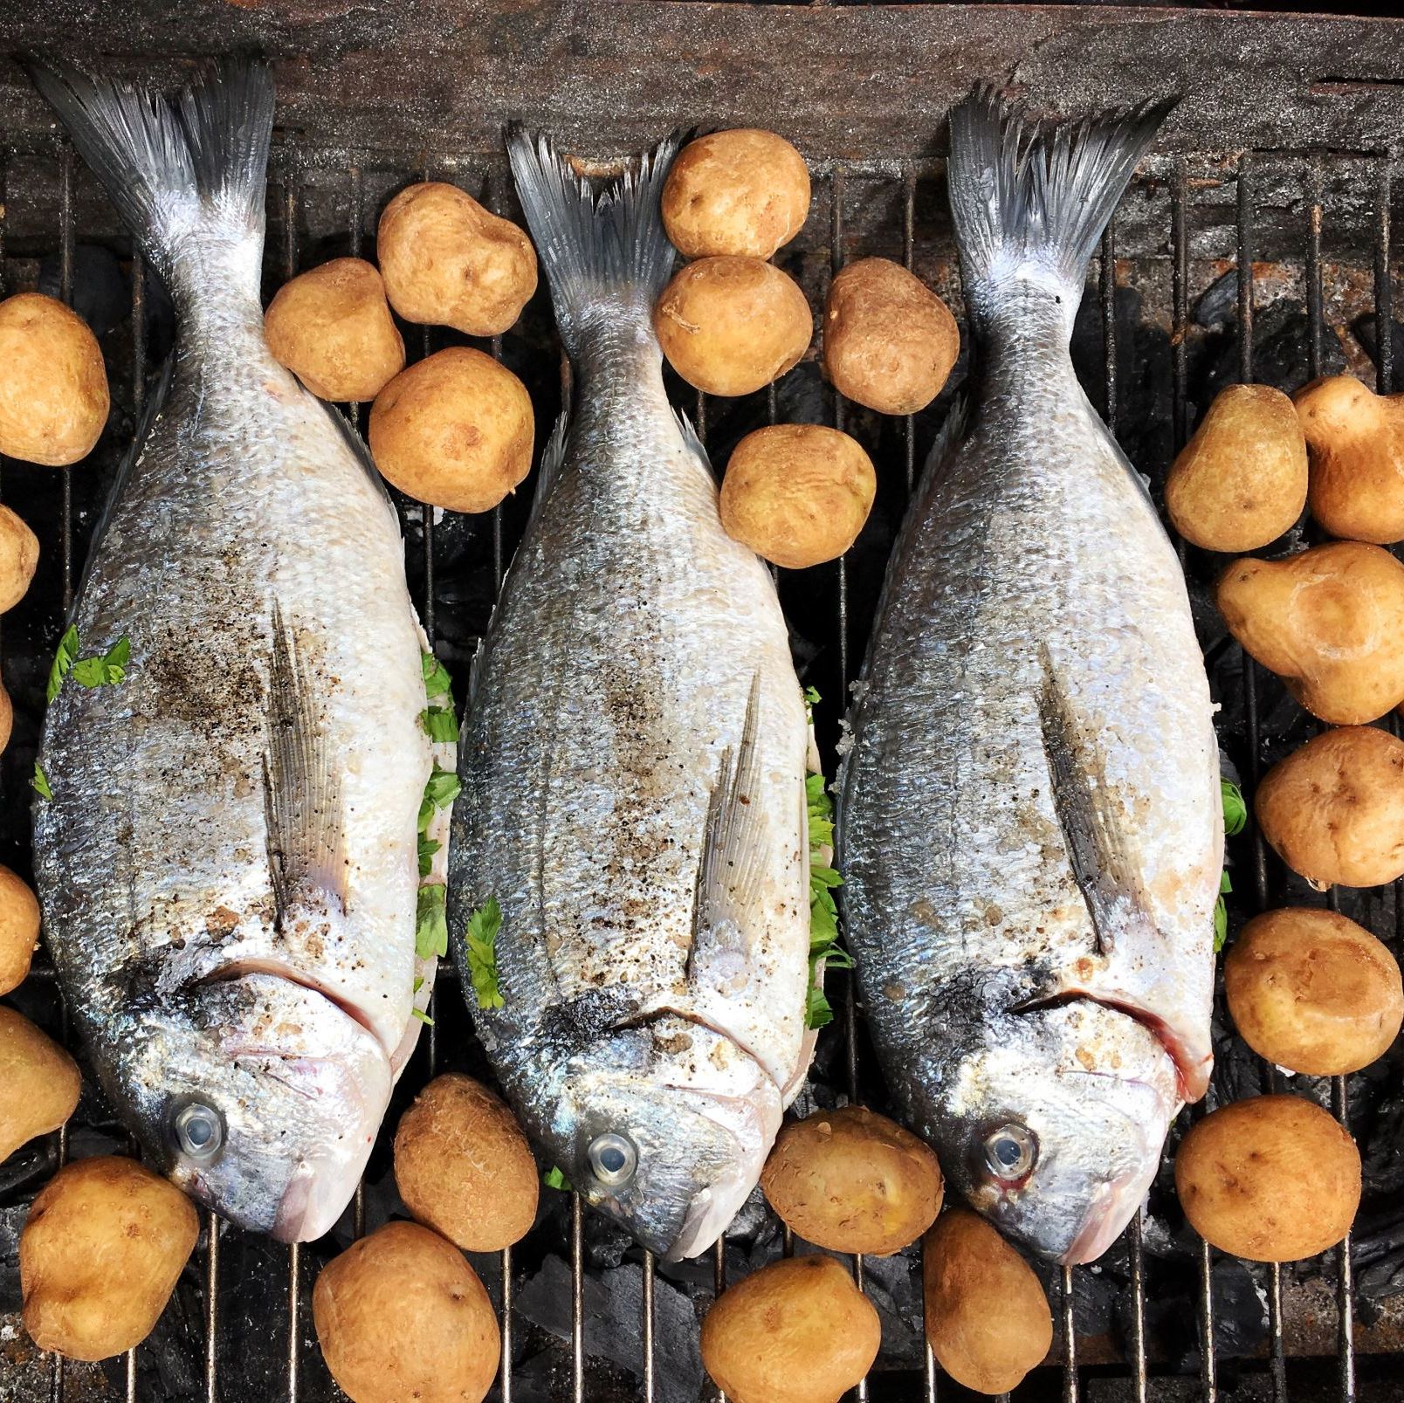
F
Fish and chips
Frogs
Freddie
Family
Fishing
Friends

Slide 8
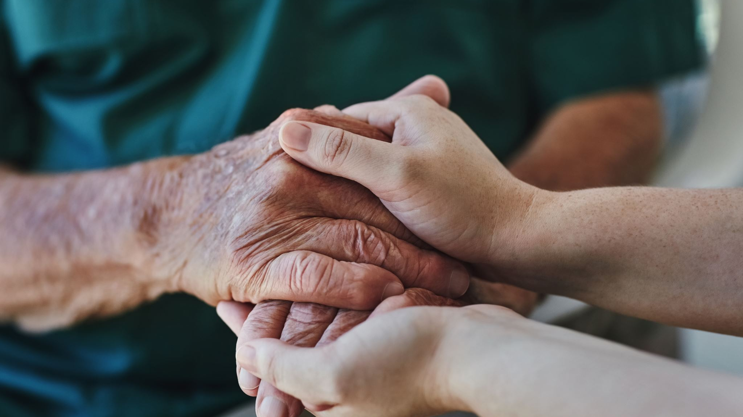
G
Grandmas (and Grandpas)

Slide 9
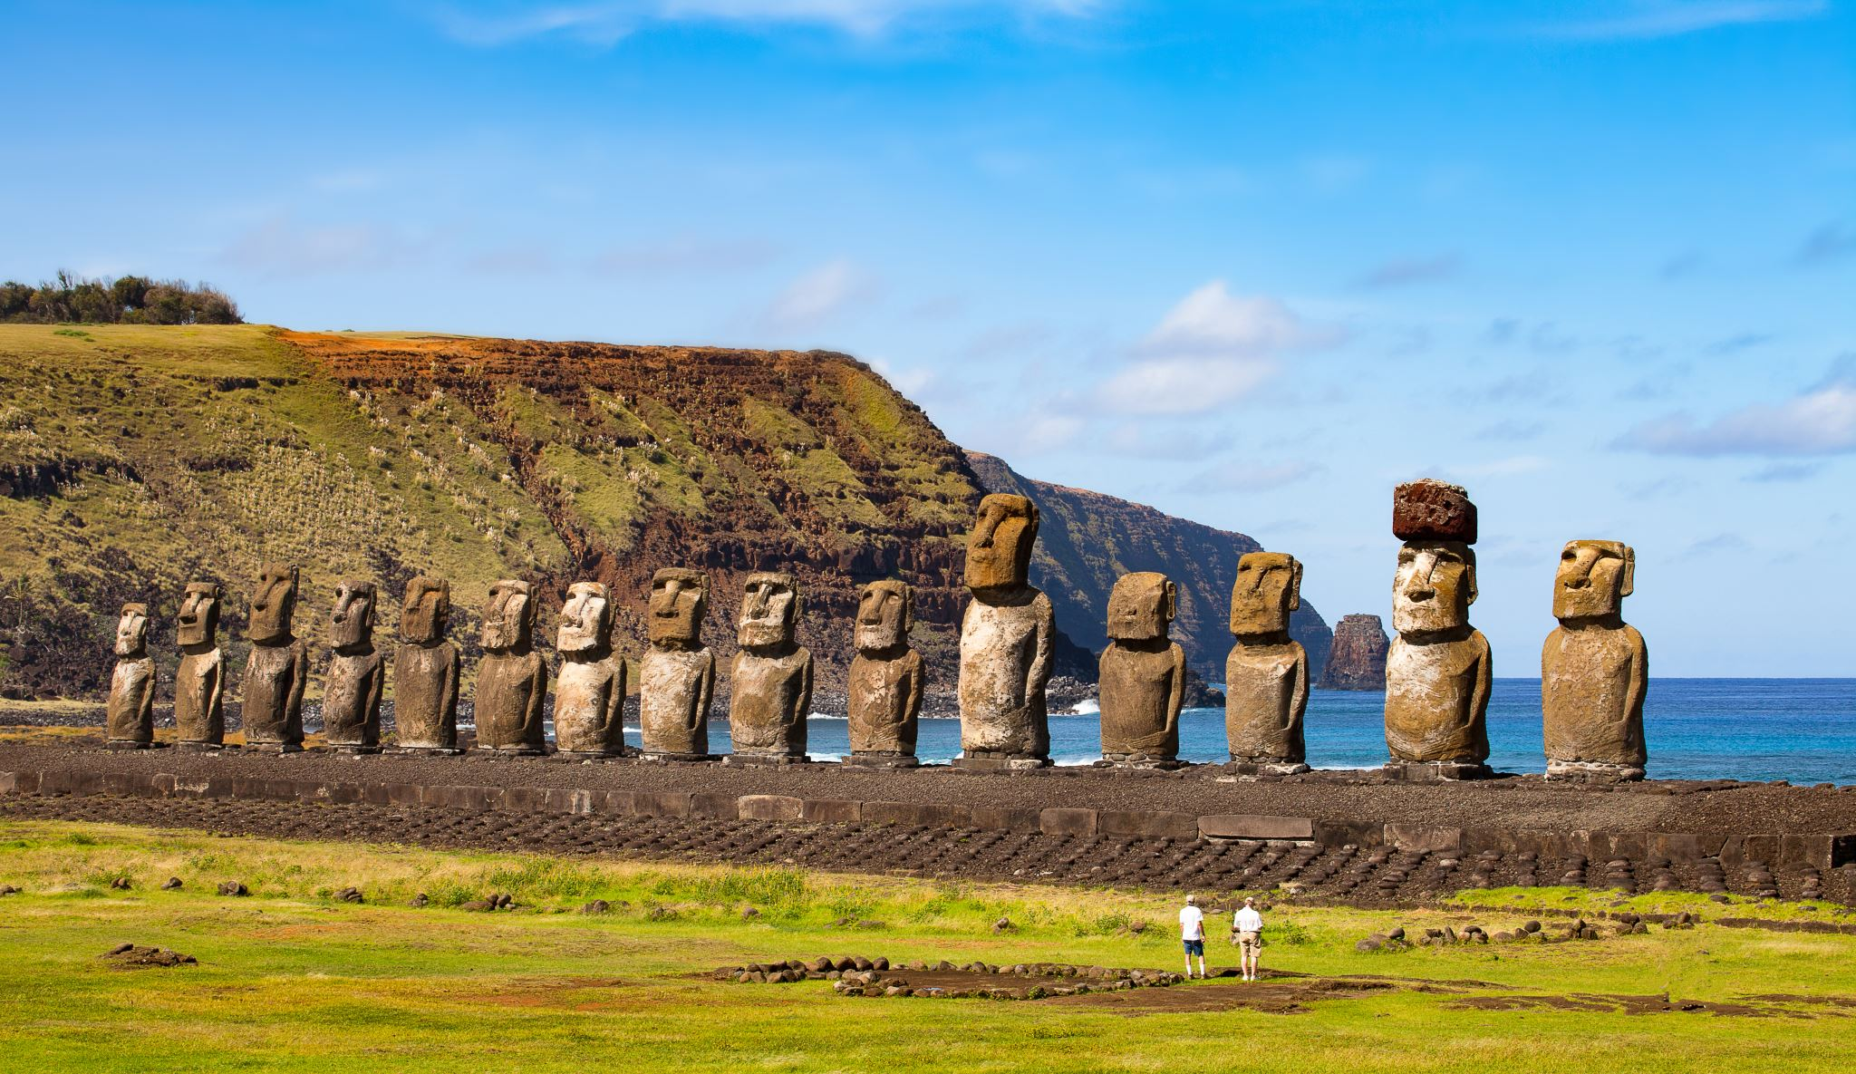
H
Heads
Harry
Henley

Slide 10
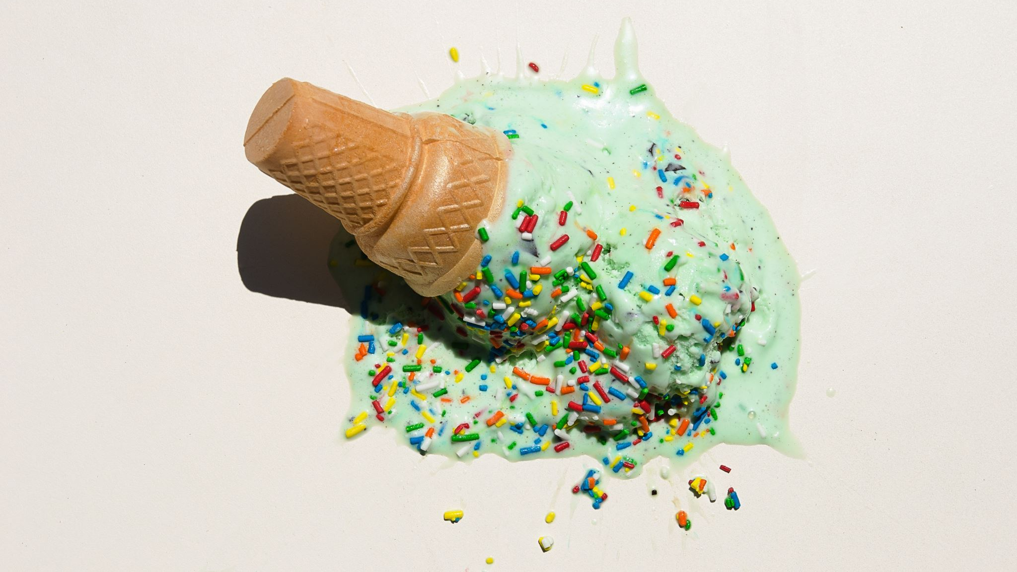
I
Ink
Ice-cream
intelligence

Slide 11
J
James McAvoy
January
Jamie
James
Joel

Slide 12

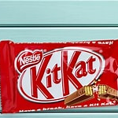
K
Kenny (both of them!)
Kit kats
King

Slide 13

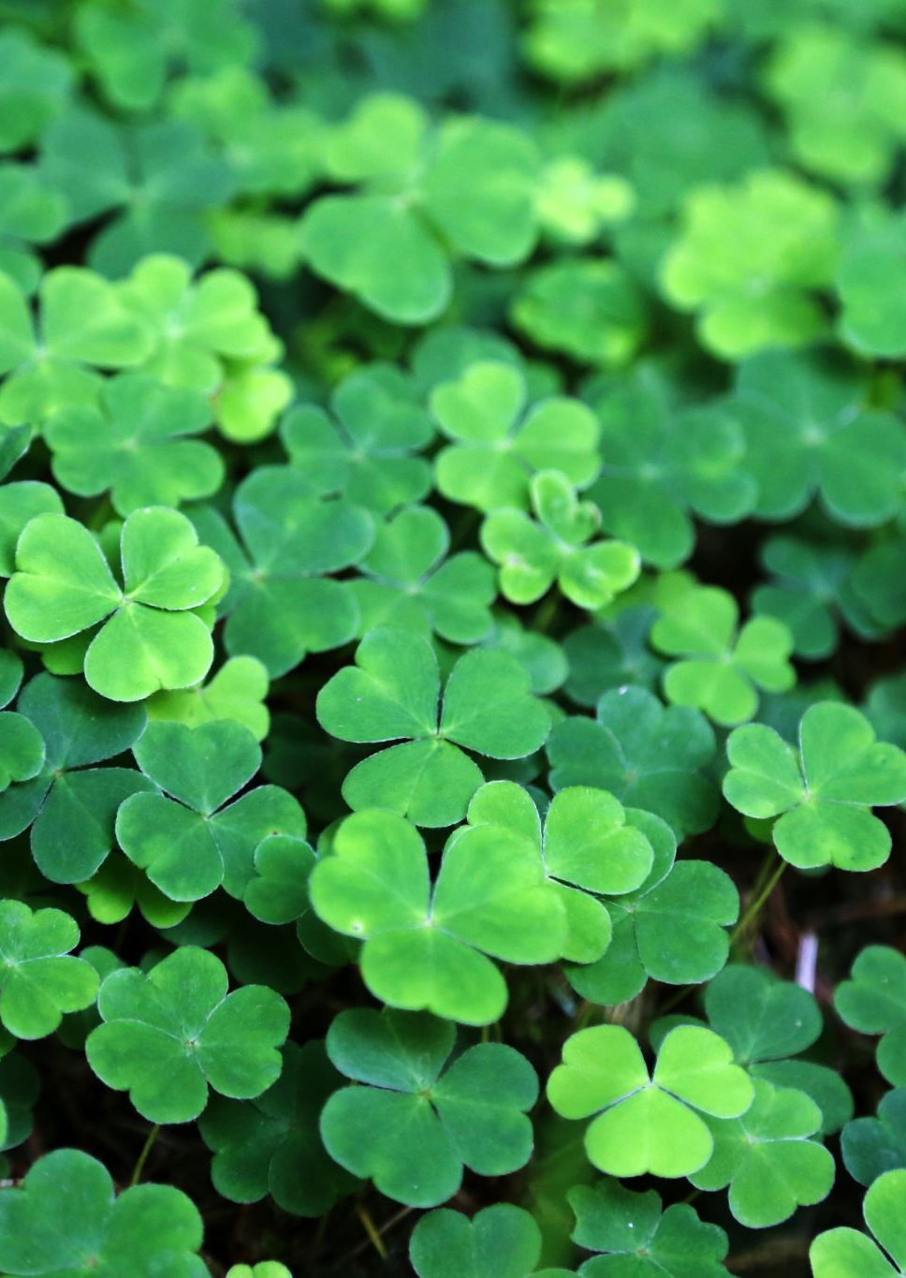
L
Land
Lyra
Life
Lilly
Lewis (both of them)
Luck

Slide 14
M
Millie
Mums
Millie-Rose
Max
Mrs Sek
Miss. Jeffries
Milk
Mouse

Slide 15
N
Nicole
Nigeria
Nice days

Slide 16
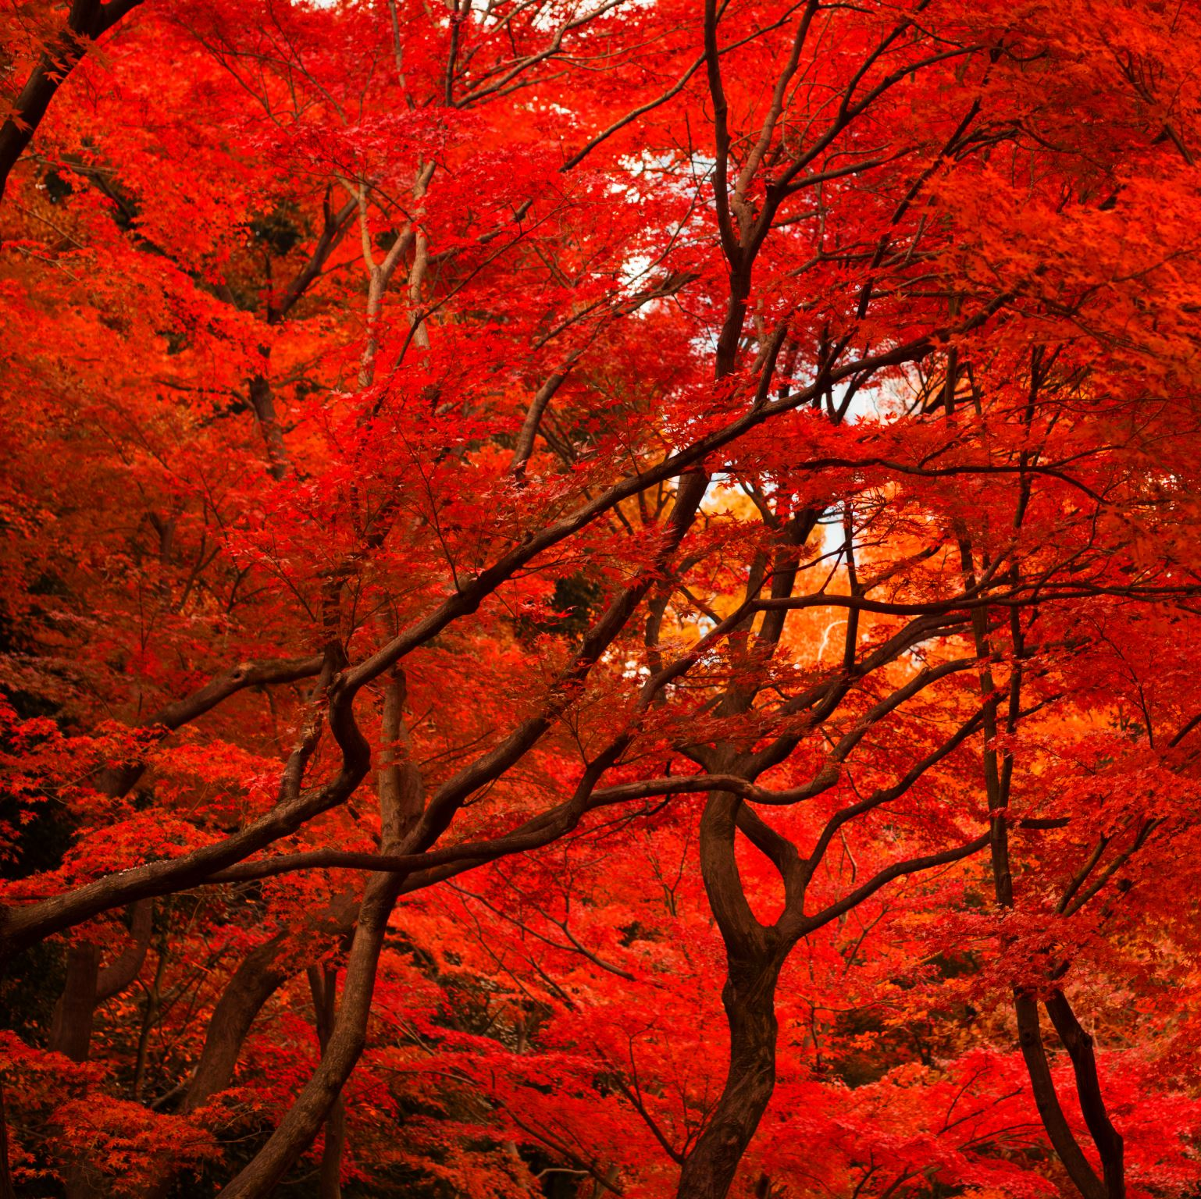
O
Oscar
Oliver Cromwell
Oxygen
October

Slide 17
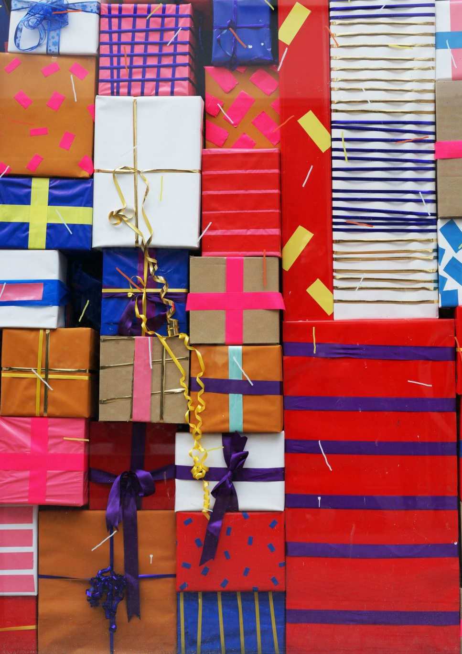
P
Pants
Paper
Pencils
Paint
Presents

Slide 18

Q
Queen
Quavers
Questions
Quiet

Slide 19
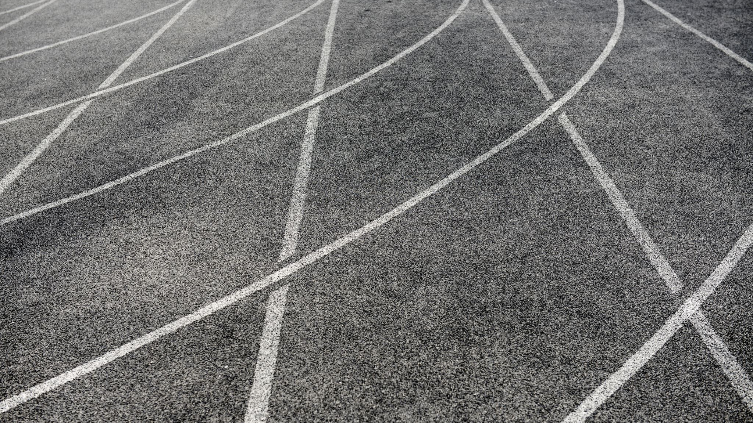
R
Running
Rolandas
Rugby

Slide 20
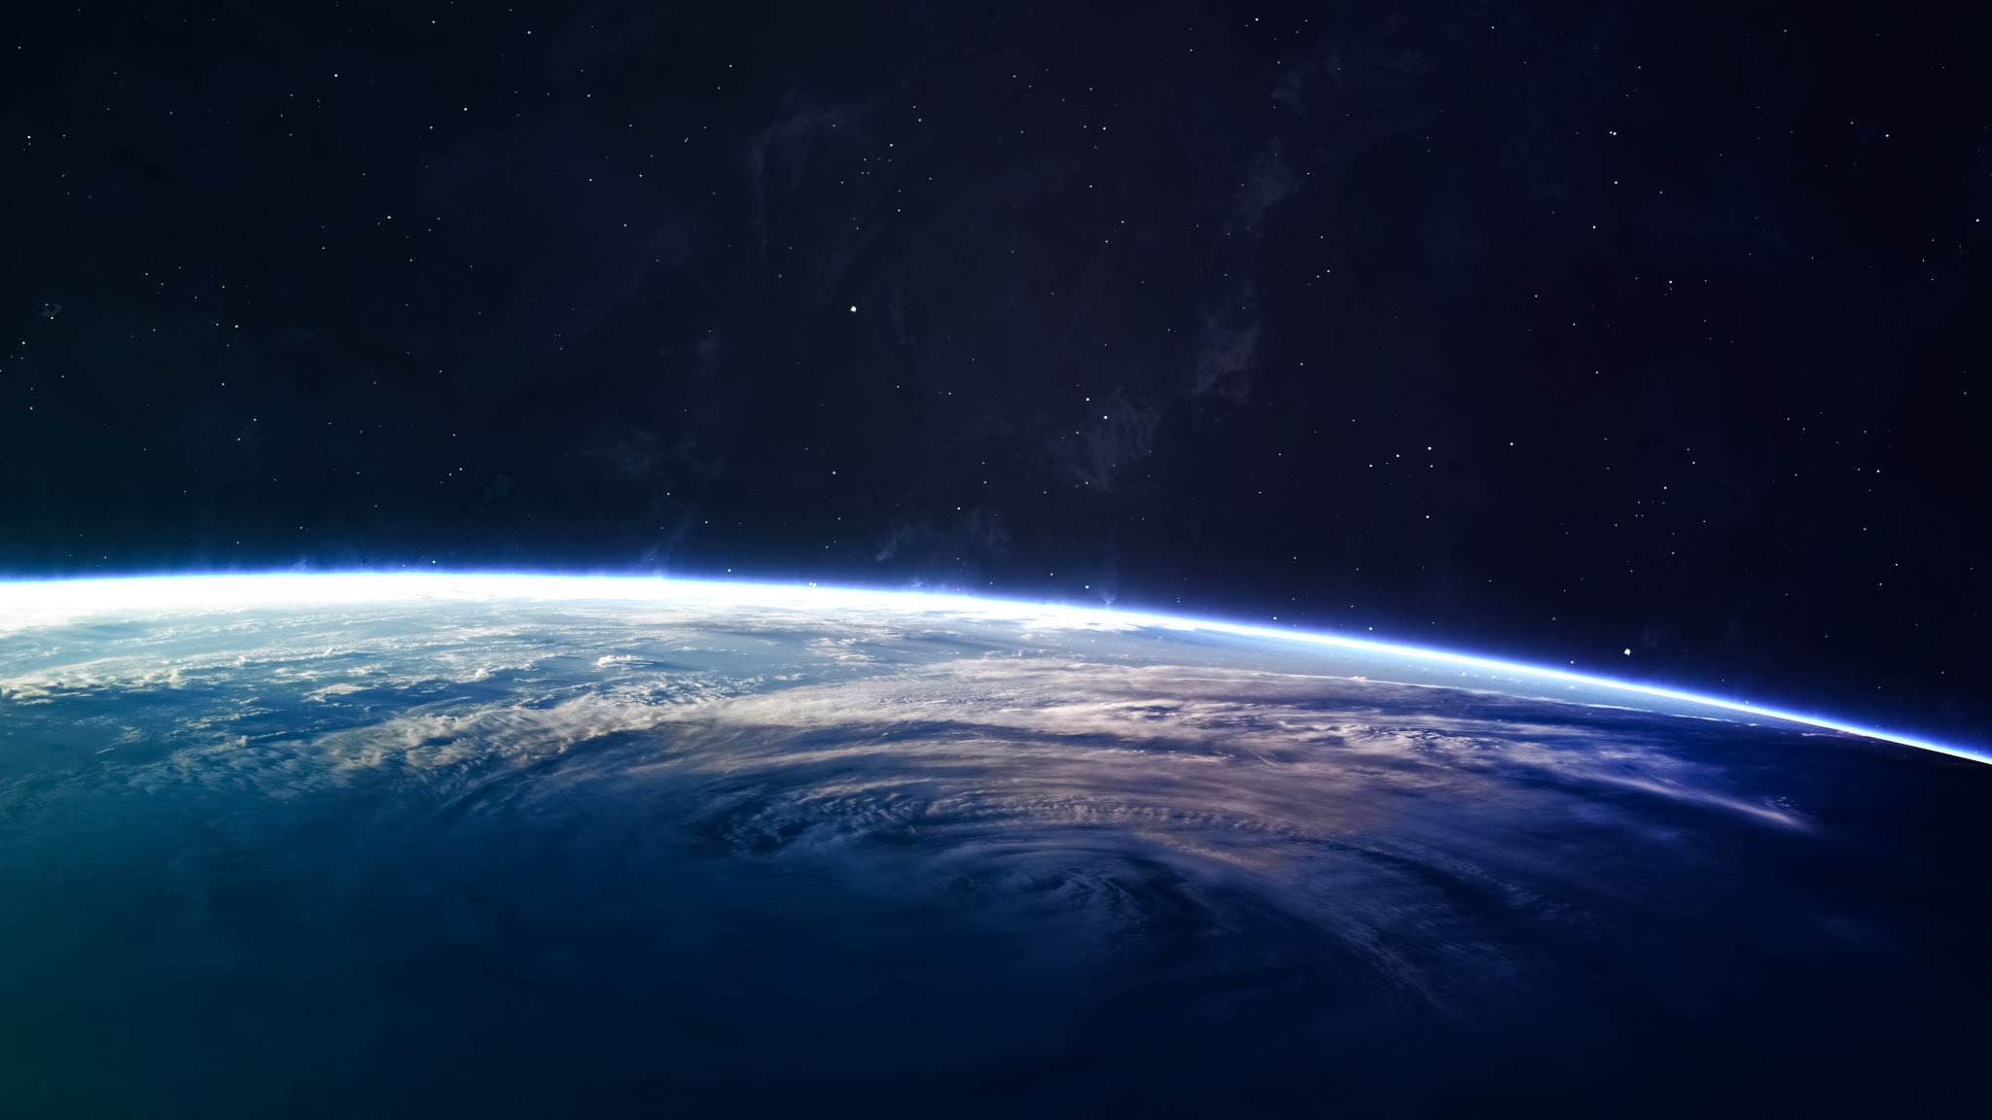
S
Satellites
Sun
Sister
Scientists
Scotland
Sekatawa
Shortbread

Slide 21
T
Teia
Taylor
Time
Talking

Slide 22

U
Umbrellas
Understanding

Slide 23
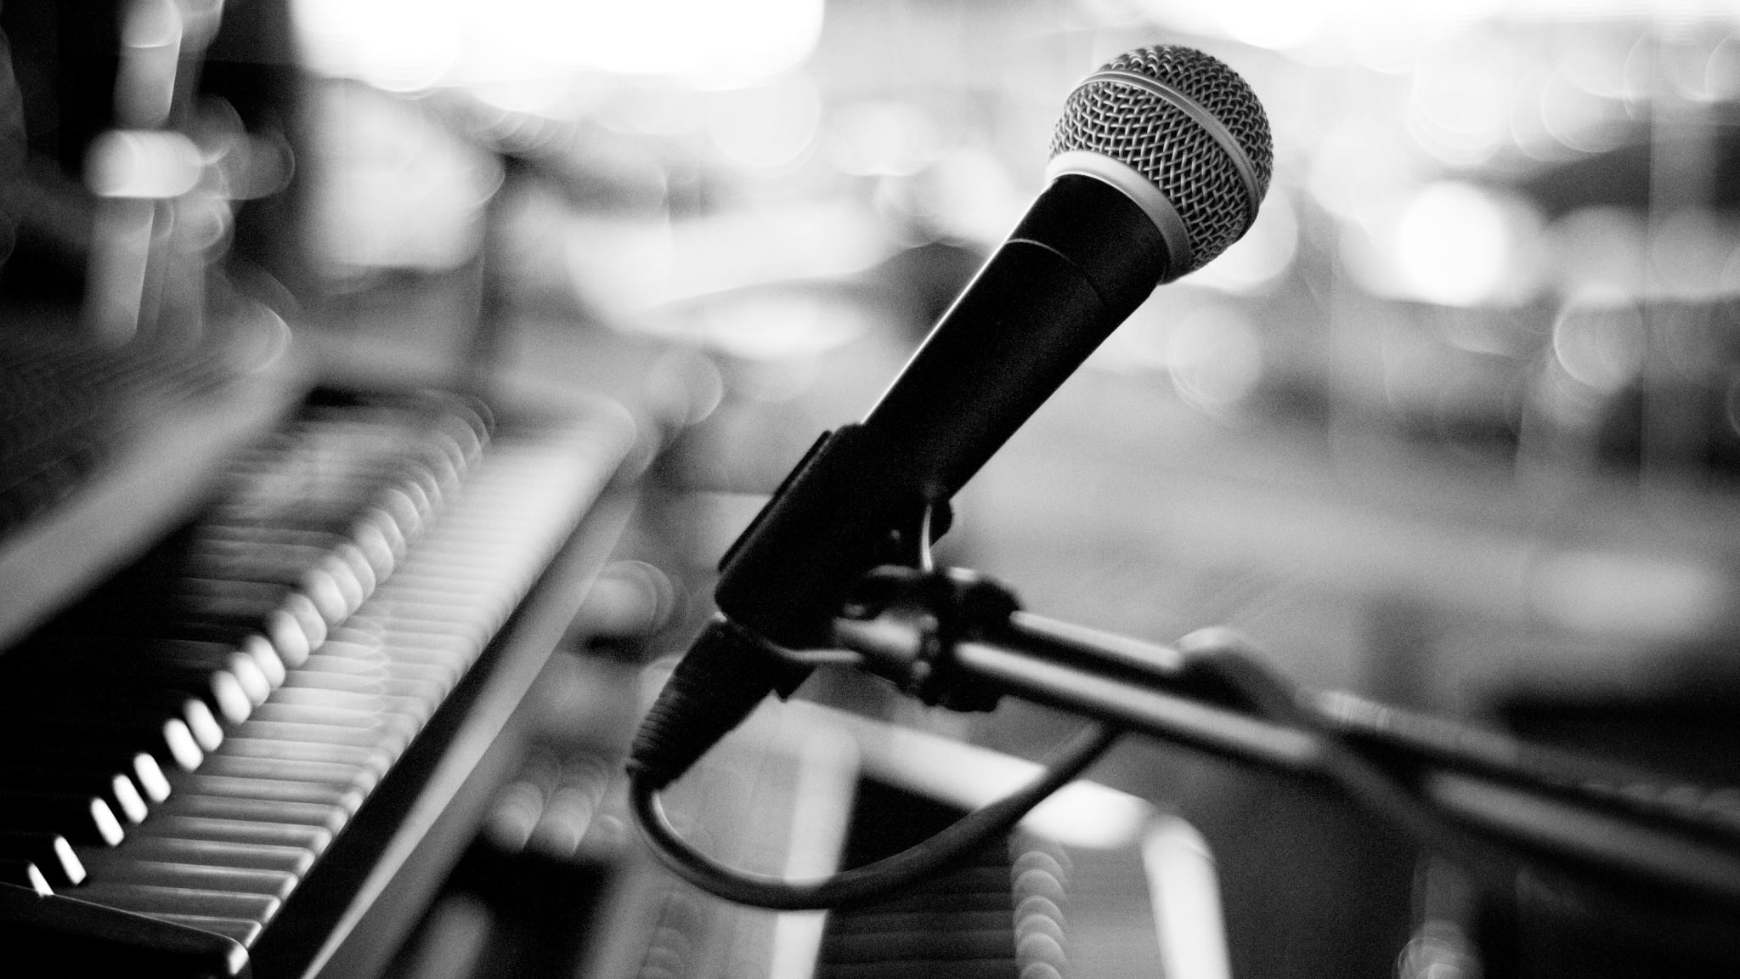
V
voices

Slide 24

W
water

Slide 25
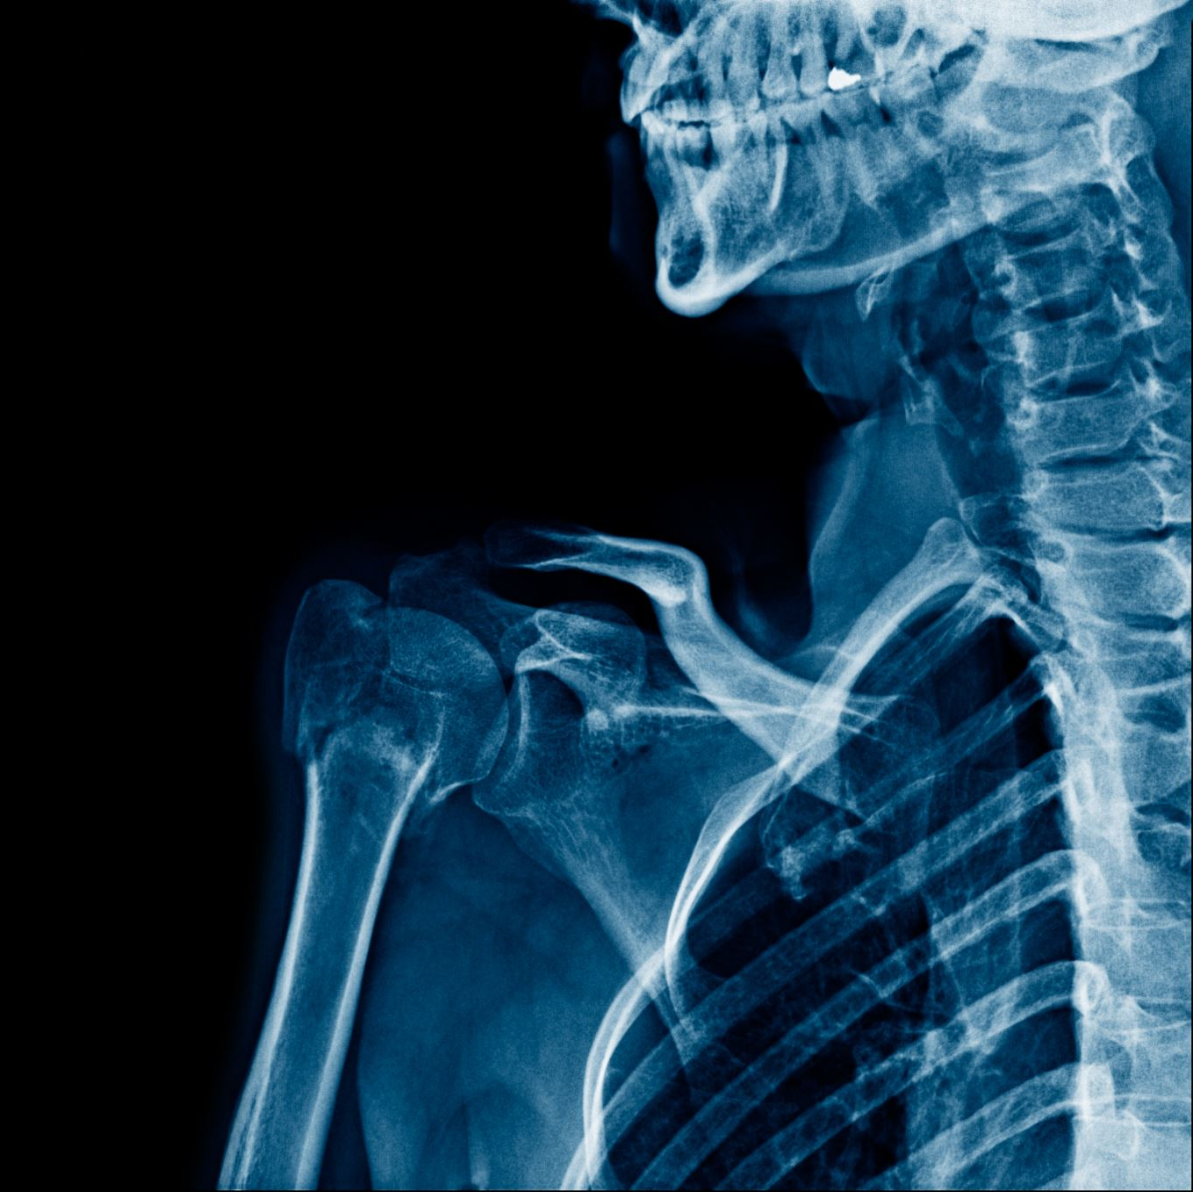
X
X factor
X rays

Slide 26
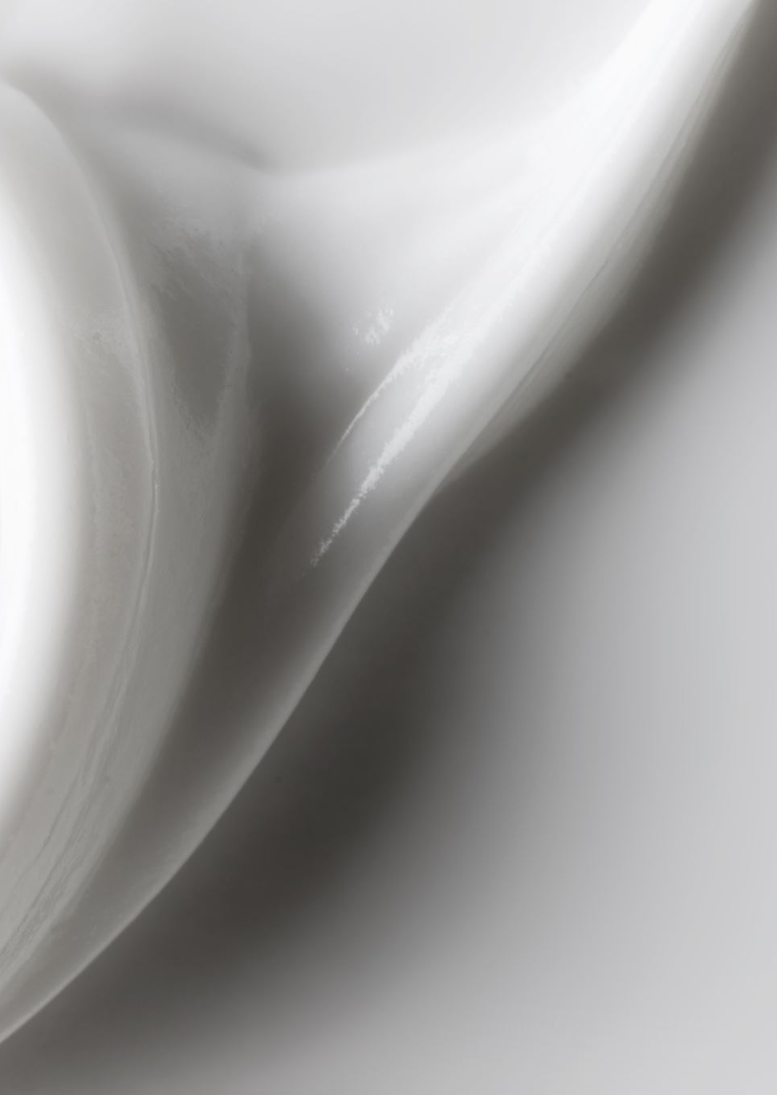
Y
Yuhan
yoghurt

Slide 27
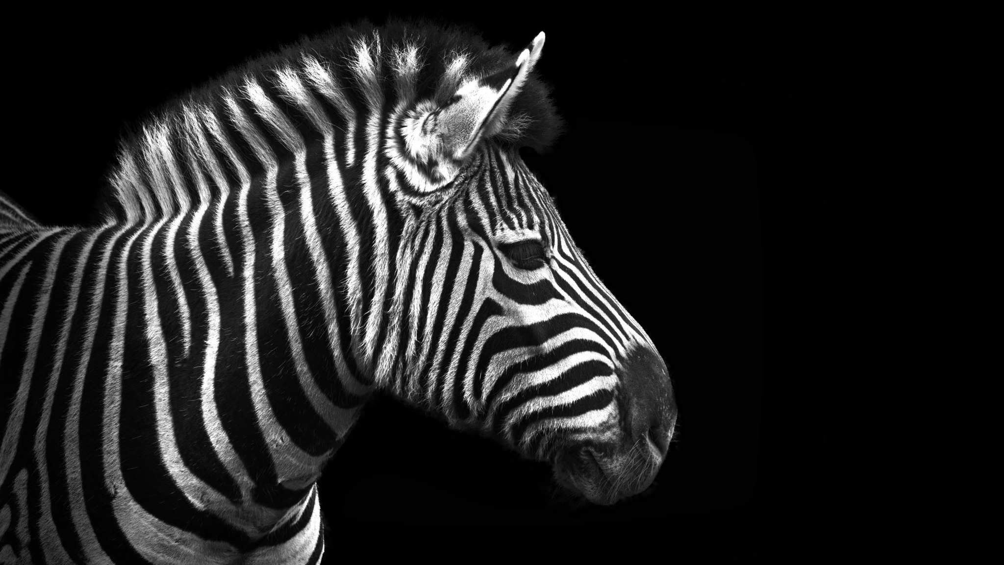
Z
Zebras
zips

